Slide 1
Testing Techniques

Slide 2
Testing Techniques
Testing techniques allow us to approach writing test cases with a certain strategy.
Often we know what to test based on the feature or user story to implement, but we may not know how to test it.
Testing techniques can help in the development of test cases.

Slide 3
Positive and Negative Testing
One way of approaching testing is to think of positive and negative cases.
A positive test case uses valid inputs to test that the system outputs the expected output.
A negative test case uses invalid inputs and tests that the system ends in the appropriate error state or throws the right exception.
Another term for these logical flows through the program is called "happy path" and "sad path", respectively.

Slide 4
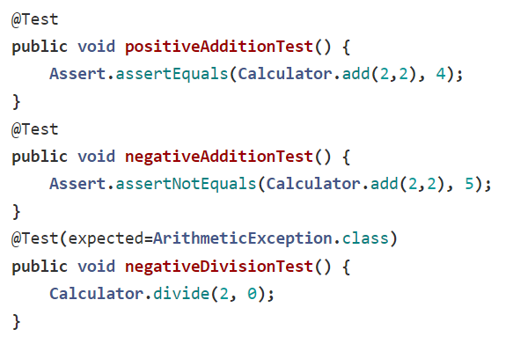
Positive and Negative Testing

Slide 5
Equivalence Partitioning
Another approach to testing is to divide inputs into different groups that share a characteristic.
These groups are called "equivalence classes".
One member of each class can be used to represent the entire class.
This allows you to reduce the number of inputs that need to be tested.
One principle of software testing is that exhaustive testing is impossible, so equivalence partitioning allows us to cover large ranges of inputs without actually testing all of them.

Slide 6
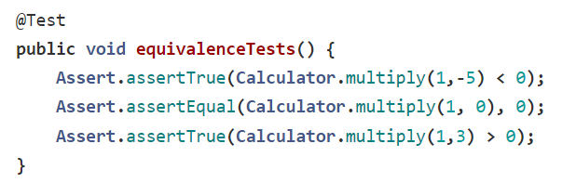
Equivalence Partitioning

Slide 7
Boundary Value Analysis
We can extend the idea of equivalence partitioning even further.
Boundary value analysis starts by observing that most defects and bugs occur at the boundaries of equivalence classes.
This is an important principle to keep in mind while testing.
This leads us to choose values from equivalence classes that are at the edges of partition ranges - for numeric inputs, these are the minimum and maximum values.
Applying this to our example, we can see that we should choose the values -1, 0, and 1, since these are the values at the boundary of positive and negative numbers.

Slide 8
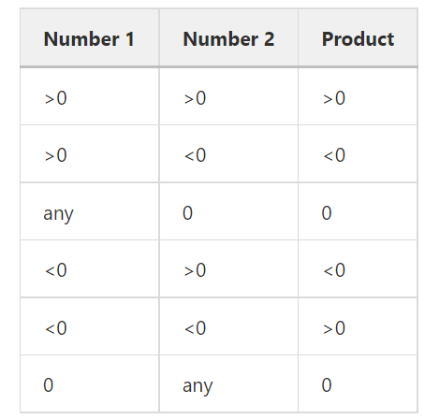
Decision Tables
One more tool we can use to identify appropriate test cases is a diagram called a decision table.
A decision table lists all combinations of inputs and includes all possible outputs based on those inputs.
It can be used to both implement functional requirements and ensure comprehensive testing of those requirements.
Let's apply this to our multiplication examples, keeping in mind we have two inputs to the function.

Slide 9
State transition diagrams
Another diagram that can aid in documenting and determining how to test a system is the state transition diagram.
This diagram depicts every possible state of the system and uses arrows to show all ways to navigate between these states.
Let's use a chess game as an example - we start with white moving first.
After white moves, it becomes black's turn.
These are the two intermediate states of the game.
Eventually, a configuration of the board will result in a checkmate or stalemate.
These outcomes lead to the end states, where we can no longer transition to any other states.
This makes sense - after the game ends, no more players can take their turn.

Slide 10
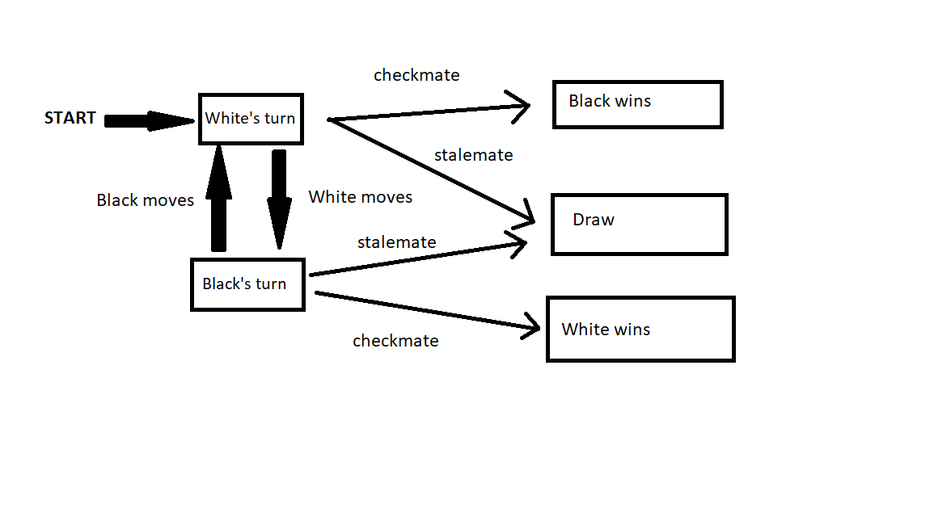
State transition diagrams
State transition diagrams can be useful for getting an overall picture of a system.
It can help to design tests that flow or transition between different states to ensure all paths through the system have been tested.

